Slide 1
SENSORSHLD1-EVK-101 Usage Guide
October 26, 2016
Kris Bahar
Applications Engineer

Slide 2
Good References
ROHM General Page:
http://www.rohm.com/web/global/multi-sensor-shield
Design Files and FW Examples
https://github.com/ROHMUSDC/ROHM_SensorPlatform_Multi-Sensor-Shield

Slide 3
General Info: SENSORSHLD1-EVK-101
Accelerometer
Accelerometer
Hall Switch Sensor
Temperature Sensor
Gyro Sensor
Pressure Sensor
Color Sensor
Accel + Mag Sensor
UV Sensor
Magnetometer Sensor
Power ON LED
ALS/Prox Sensor
Accelerometer
Accelerometer

Slide 4
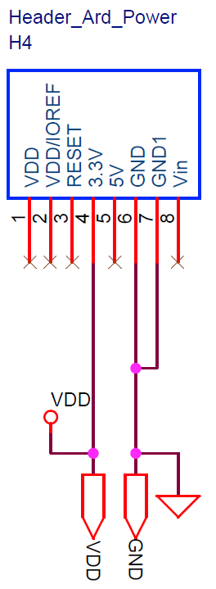
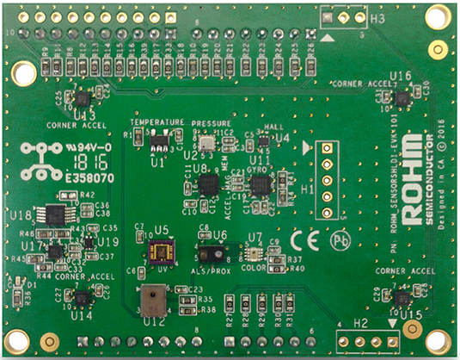
General Info: Board Power
Power is routed to the board via H4 Header
NOTE: Be sure that this is connected to 3.3V only; some sensors on board will break due to 5V
VDD
GND

Slide 5
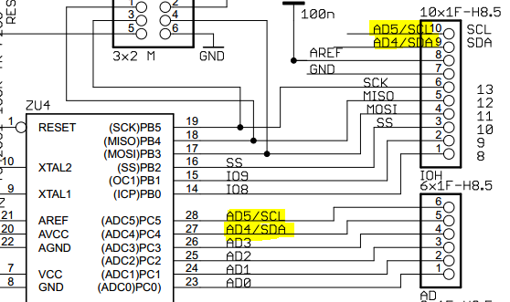
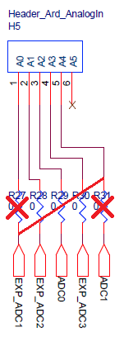
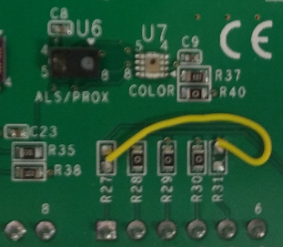
Setup: Arduino Recommended Rework
On the Arduino UNO board, the I2C pins connected to the top left header are routed to pins A4 and A5 on the bottom right connector.
This conflicts with the UV sensor’s ADC output.
Thus, to reroute this on our board, we suggest the following rework…
Disconnect existing nets by removing R27, R31
Reconnect UV sensor ADC by connecting the top pad of R31 to the bottom pad of R27
Arduino Uno R3 Schematic
ROHM Shield Rework Recommendation

Slide 6
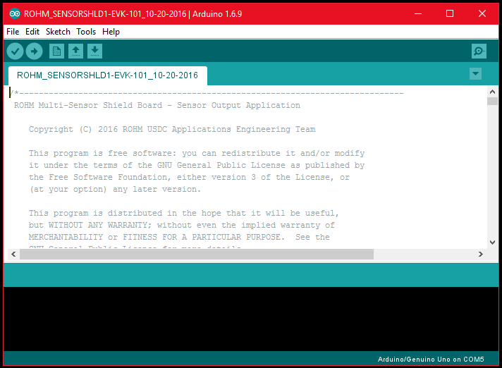
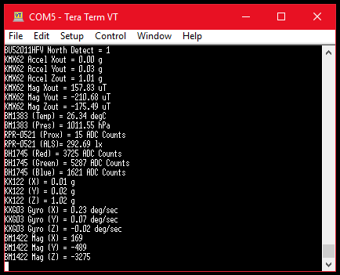
Setup: Environment Preparation
Needed: Install the Arduino Software IDE.
https://www.arduino.cc/en/Guide/Windows
Recommended: Install TeraTerm
Recommendation since serial monitor is available within the Arduino IDE.
However, this includes good functions such as logging display of special ASCI character sets.
https://ttssh2.osdn.jp/index.html.en

Slide 7
Setup: Download Code and Open in Arduino IDE
Download the example sensor shield code found in the GitHub Repository
https://github.com/ROHMUSDC/ROHM_SensorPlatform_Multi-Sensor-Shield
…/Platform Code/Arduino_UNO_FirmwareExample/
Open the file named “ROHM_SENSORSHLD1-EVK-101_10-20-2016.ino” in the Arduino IDE
Install the SoftI2CMaster Library.
We can not use the general “wire” library for standard I2C because we want to utilize the repeated start bit of the I2C interface protocol to properly read data back from our sensor devices
Instructions on how to install
http://playground.arduino.cc/Main/SoftwareI2CLibrary
Where to download the library itself
https://github.com/felias-fogg/SoftI2CMaster

Slide 8
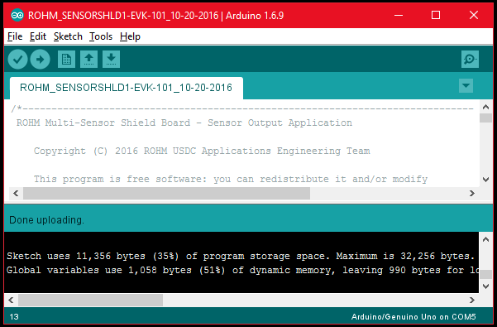
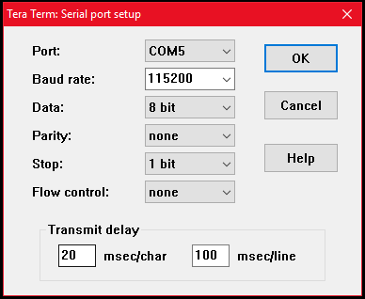
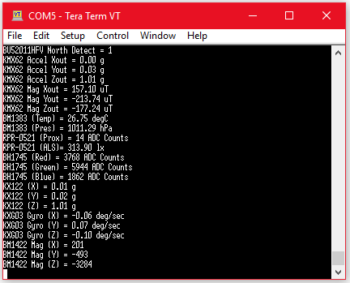
Setup: Flash Board and View Output
In order to flash the board, click the “verify” button to compile your code.
Once this completes and returns with no errors, click the “upload” button
The dialog box will return with “Done uploading” when complete
Verify
To view the sensor output, open the serial monitor or Tera Term
If using Tera Term, configure the Tera Term Serial Port to the above settings (Setup -> Serial Port)
Then, open a new connection (Alt-N), select the appropriate COM port, and click OK
Once completed, the connection will open and sensor data will stream to the console

Slide 9
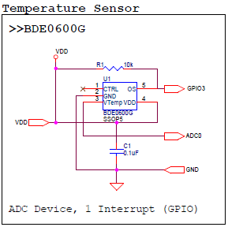
Sensor Explanation: BDE0600G Temp Sensor
Datasheet:
http://rohmfs.rohm.com/en/products/databook/datasheet/ic/sensor/temperature/bdexxx0g-e.pdf
Communication Interface:
Analog Output
Thermostat Interrupt (55°C to 115°C in 5°C steps)
How to Convert:
Known Values
Temperature Sensitivity = -10.68mV/degC
Temp Known Point = 1.753V @ 30 degC
Calculation
ADC_Voltage = (sensorValue / 670) * 3.3V
ADC_Voltage = sensorValue * 0.004925
Temperature (in deg C) = (ADC_Voltage - 1.753)/(-0.01068) + 30
Typical Use Cases:
Temperature Detection
Battery Management
Heat Management
Thermostat Interrupt Detection

Slide 10
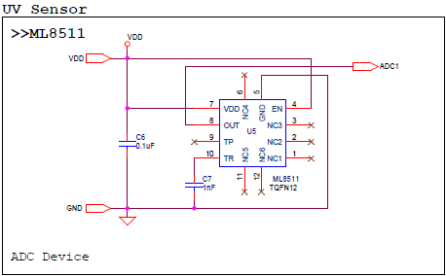
Sensor Explanation: ML8511 UV Sensor
Datasheet:
http://media.digikey.com/pdf/Data%20Sheets/Rohm%20PDFs/ML8511_3-8-13.pdf
Communication Interface:
Analog Output
What does this measure?
UV intensity in mW/cm²
How to Convert:
Known Values
UV Sensitivity = 0.129 V/(mW/cm²)
Temp Known Point = 2.2V @ 10mW/cm²
Calculation
ADC_Voltage = (sensorValue / 670) * 3.3V
ADC_Voltage = sensorValue * 0.004925
UV Intensity (in mW/cm²) = (ADC_Voltage - 2.2)/(0.129) + 10
Typical Use Cases:
Outdoor Detection
UV Index Approximation

Slide 11
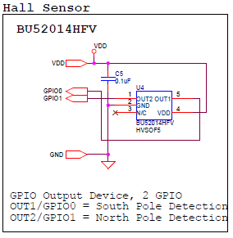
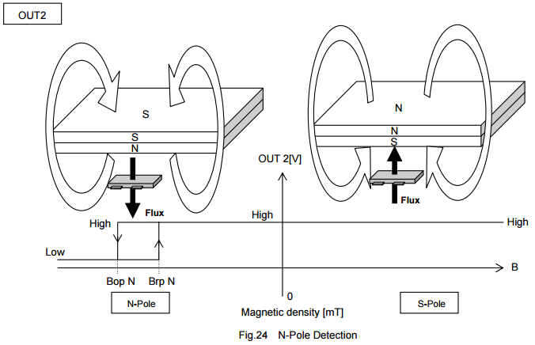
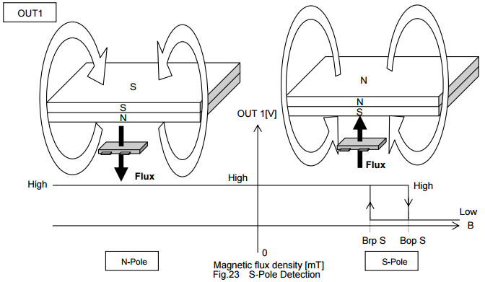
Sensor Explanation: BU52014 Hall Sensor
Datasheet:
http://rohmfs.rohm.com/en/products/databook/datasheet/ic/sensor/hall/bu52004gul-e.pdf
Communication Interface:
Digital Logic Output (H/L)
What does this measure?
Magnetic Flux Presence
How to Interpret:
OUT1/GPIO0 is tied to South Pole Detection Pin
Pin Output LOW on South Detect
OUT2/GPIO1 is tied to North Pole Detection Pin
Pin Output LOW on North Detect
Typical Use Cases:
Contactless Switch
Tablet/Phone Case

Slide 12
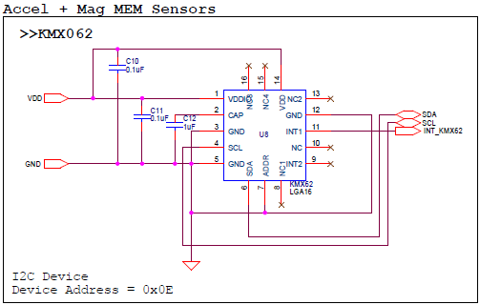
Sensor Explanation: KMX62 Accel + Mag Sensor
Datasheet:
http://kionixfs.kionix.com/en/datasheet/KMX62-1031%20Specifications%20Rev%203.0.pdf
Communication Interface:
I2C
What does this measure?
Acceleration, 3 Axis, 14bit, ±16g
Magnetic Flux, 3 Axis, 14bit, ±1200µT
How to Interpret
Perform 12 Bytes I2C Data Read
Format 12 Bytes of Data into the six 14bit raw sensor output (Accel X/Y/Z, Mag X/Y/Z)
Convert Using Appropriate Scheme
ACCEL = Axis_ValueInG = MEMS_Accel_axis / 2048
MAG = Axis_ValueInuT = MEMS_Mag_axis / 0.146
Typical Use Cases:
Low Power Gyro
Compass Orientation

Slide 13
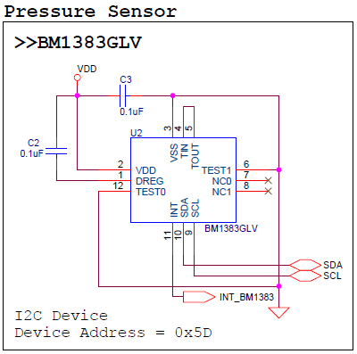
Sensor Explanation: BM1383 Pressure Sensor
Datasheet:
http://rohmfs.rohm.com/en/products/databook /datas heet/ic/sensor/pressure/bm1383glv-e.pdf
Communication Interface:
I2C
What does this Measure?
Barometric Pressure, 16bit + 5bit decimal, 300hPa to 1100hPa
How to Convert:
Perform 3 Bytes I2C Data Read
Format 3 Bytes of Data into the pressure output conversion formula
Pressure Value[hPa] = { PRESS_OUT[15:8], PRESS_OUT[7:0], PRESS_OUT_XL[5:0] } / 2048
Typical Use Cases:
Height/Altitude Detection

Slide 14
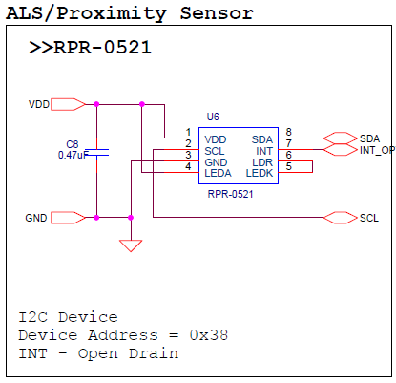
Sensor Explanation: RPR-0521 ALS+PROX Sensor
Datasheet:
http://www.rohm.com/web/global/datasheet/RPR-0521RS
Communication Interface:
I2C
What does this measure?
Ambient Light, 0 to 43000 Lx
Proximity Detection, within 100mm maximum
How to Convert:
Perform 6 Bytes I2C Data Read (4 for ALS, 2 for Prox)
Format 4 Bytes of Data into 16bit values for DATA0 (Visible Light) and DATA1 (Infrared Light)
Format 2 Bytes of Data into 16bit value for Proximity ADC Counts
Perform Conversion of Raw Data to Lx (see next slide)
Typical Use Cases:
Mobile Phones (brightness optimization and ear detect)
Contactless Switch/Presence Detection

Slide 15
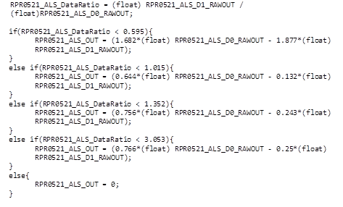
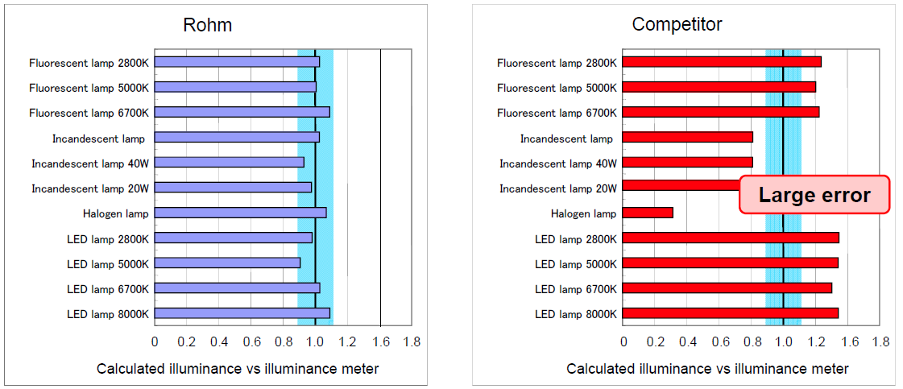
ALS Sensor Conversion Equation
Q: Why does this equation look so complex?
A: This ALS sensor utilizes 2 photodiodes, one for visible light and one for ambient light.
This ratio based piecewise function allows us to properly reject high IR based output and generate a good lux output based on the actual visible light spectrum

Slide 16
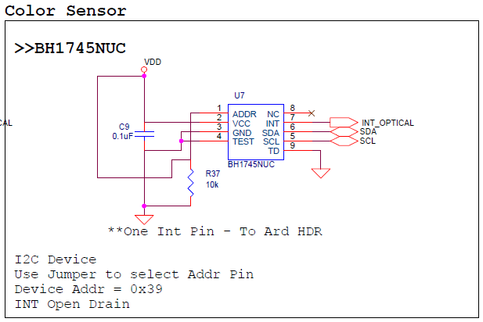
Sensor Explanation: BH1745NUC Color Sensor
Datasheet:
http://rohmfs.rohm.com/en/products/databook/ datasheet/ic/sensor/light/bh1745nuc-e.pdf
Communication Interface:
I2C
What does this measure:
Ambient Light, 0.005 to 40k lx
Individual photo diode ADC output for Red, Green, and Blue output
How to Convert:
Perform 6 Bytes I2C Data Read (2 Bytes for each color: Red, Green, Blue)
Format 2 Bytes of Data into 16bit values for RED, GREEN, and BLUE intensity values
Typical Use Cases:
Color Balancing (Lighting)
Industrial Machinery (Defect Detection)

Slide 17
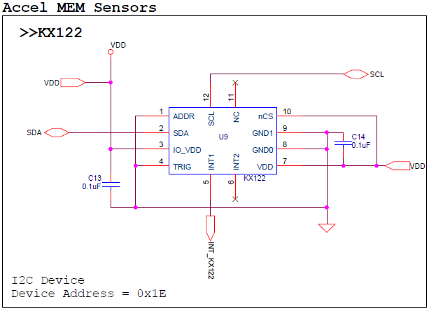
Sensor Explanation: KX122 Accelerometer Sensor
Datasheet:
http://kionixfs.kionix.com/en/datasheet/KX122-1037%20Specifications%20Rev%204.0.pdf
Communication Interface:
I2C
What does this measure:
Acceleration, 3 Axis, 16bit, ±8g
Built-in features like Tap/Double Tap Detection, Activity Detection, Free Fall Detection, etc.
How to Convert:
Perform 6 Byte I2C Data Read
Format 6 Bytes of Data into the six 16bit raw sensor output (Accel X/Y/Z)
Convert Using Appropriate Scheme
ACCEL = Axis_ValueInG = MEMS_Accel_axis / 16384
Typical Use Cases:
Built-in Features (Tap Detection, Activity Detection, Free Fall engine, etc.)
Low Power Wearable Devices (0.9uA standby, 10uA low resolution mode)

Slide 18
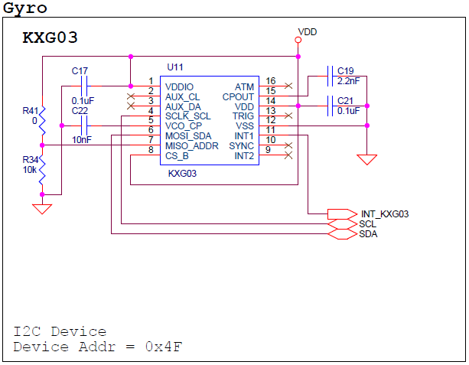
Sensor Explanation: KXG03 Accel + Gyro Sensor
Datasheet:
http://kionixfs.kionix.com/en/datasheet/ KXG03%20Specifications%20Rev%201.0.pdf
Communication Interface:
I2C
What does this measure?
Acceleration, 3 Axis, 16bit, ±16g
Angular Velocity, 3 Axis, 16bit, ±2048°/sec
How to convert?
Initialize Gyro: take readings when Gyro is not moving; save this value as Gyro Offset (RAW value OK)
Perform 12 Byte I2C Data Read
Format 12 Bytes into the six 16bit raw sensor output (Accel X/Y/Z, Gyro X/Y/Z)
Convert Using Appropriate Scheme
ACCEL = Axis_ValueInG = MEMS_Accel_axis / 16384 (±2g)
GYRO = Axis_ValueinDegPerSec = MEMS_Gyro_axis * 0.007813
Typical Use Cases:
6 Axis Motion Sensor (Sensor Fusion via Complimentary Filtering or Kalman Filter)
9 Axis Motion Sensor by adding Magnetometer Sensor
Motion Controller (Wii Controller), or Motion Feedback (Quadcopter)

Slide 19
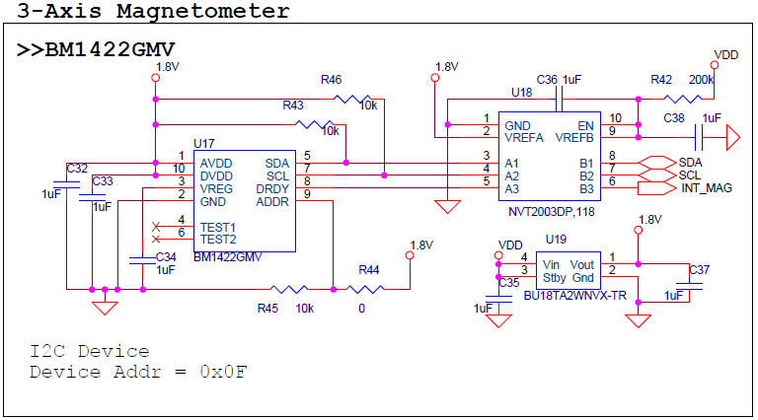
Sensor Explanation: BM1422 Magnetometer Sensor
Datasheet:
https://github.com/ROHMUSDC/ROHM_Sensor Platform_Multi-Sensor-Shield/blob/master/Documentation/Sensor%20Datasheets /ROHM_MAG-IND_BM1422GMV.pdf
Communication Interface:
I2C
What does this measure?
Magnetic Flux, 3 Axis, 16bit, ±1200µT, 0.042µT/LSB
How to Convert:
Perform 6 Byte I2C Data Read
Format 6 Bytes of Data into the three 16bit raw sensor output (Mag X/Y/Z)
Convert Using Appropriate Scheme
MAG = Axis_ValueInuT = Mag_axis_RawOut * 0.042
Typical Use Cases:
9 Axis Motion Sensor (by adding Accel+Gyro Sensor)
E-compass
Contactless Current Sensor

